Slide 1
Candidate Information Workshop
June 7, 2022 Primary Election
Santa Cruz County Clerk
January 12, 2022

Slide 2
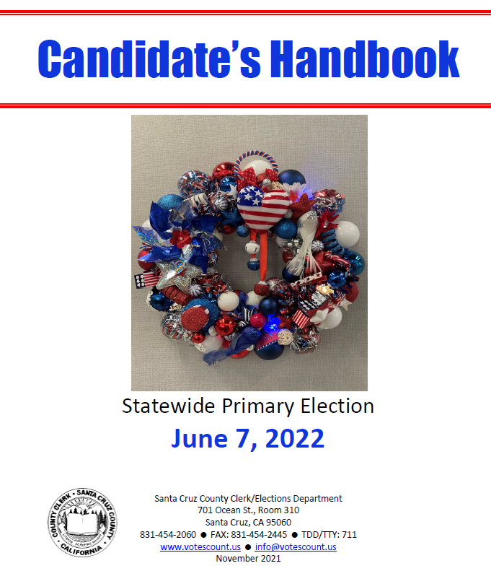
Candidate’s Handbook is posted online at www.votescount.us
Hard copies available at Clerk/Elections.

Slide 3
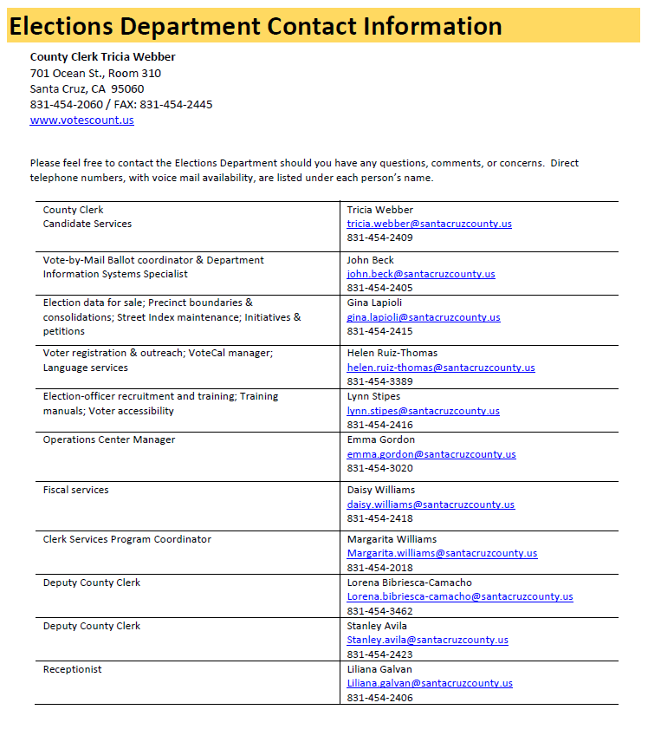
How to contact us.
Ask questions.
Get help!

Slide 4
State and Federal Offices
Fair Political Practices Commission: Campaign reporting (Forms 501, 410, 460, 470, 497…); Conflict of Interest Form 700; investigates campaign violations
Secretary of State: File Form 410; conducts random alpha to determine order of candidate’s names; investigates voter fraud
Attorney General: legal opinions; incompatibility of offices
Franchise Tax Board: Audits campaign reports
Federal Election Commission: Campaign reporting for federal offices
State and Federal Offices

Slide 5
Who to call for election violations?
False or misleading campaign materials (No agency enforcement. These issues are dealt with in court).
Violations of the Political Reform Act: contact the Fair Political Practices Commission at www.fppc.ca.gov, 866-275-3772.
Election fraud: contact your local district attorney, 454-2400, or the California Secretary of State at www.sos.ca.gov, 916-657-2166.
Vandalism or requirements concerning campaign signs: contact local city attorney or district attorney, or local law enforcement.
In other words… not my office!

Slide 6
Key Dates and Deadlines
3 Jan. – 9 Feb.
Signatures in lieu period
14 Feb. – 11 Mar.
Candidate filing
12–16 Mar.
Candidate filing extension if the incumbent does not file
17 Mar.
Random Alpha – SOS alpha will determine order of local contests. County random will determine order of State Assembly
8 Apr.
Military and Overseas ballots go out - RAVBM
9 May
Vote by mail ballots go out
23 May
Last day to register to vote
28 May – 7 June
Voter service centers open
9am to 5pm on Saturdays and Sundays
8am to 5pm on Weekdays
7am to 8pm on Election Day, Tuesday June 7

Slide 7
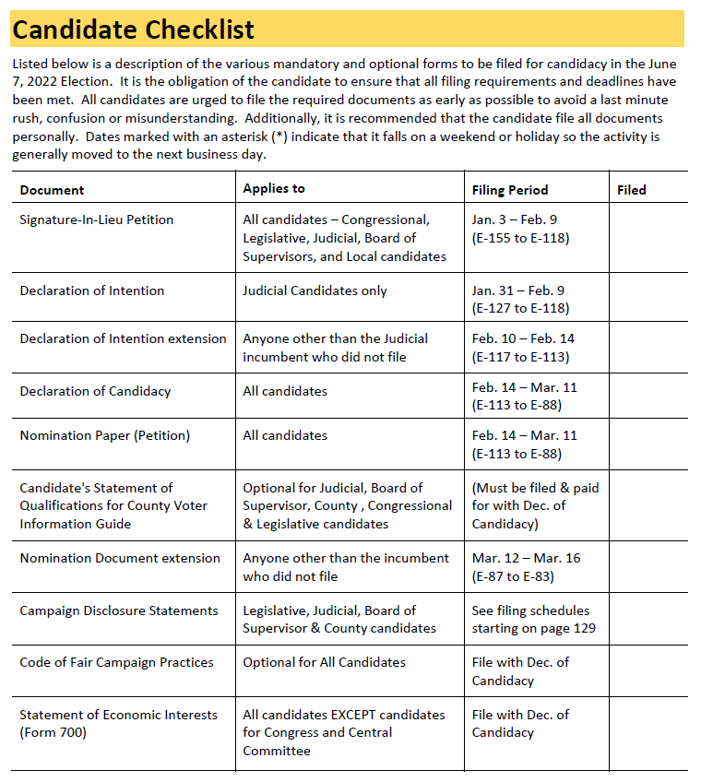
Candidate Checklist
Use our website!
www.votescount.us

Slide 8

Offices on the ballot
Nominees for:
Congress
State Assembly
Superior Court Judge – 4 seats
County Supervisor, 3rd District
County Supervisor, 4th District
Assessor-Recorder
Auditor-Controller-Treasurer-Tax Collector
County Clerk
County Superintendent of Schools
District Attorney/Public Administrator
Sheriff-Coroner

Slide 9
Filing for Candidacy
Schedule
Although not required, scheduling an appointment is encouraged. Email candidates@votescount.us or phone 831-454-2060.
Issue
The Elections Department will issue you Signatures in Lieu of Filing Fees petitions or Nomination papers.
Collect
Collect valid signatures from voters within your jurisdiction. 20 for County offices, 40 for BOE, Congress and Assembly, 65 for State offices and US Senator.

Slide 10
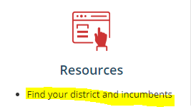
Where you live determines what you can run for
For most offices, you must be a registered voter of the jurisdiction and in some cases, you must live in the subdivision of the jurisdiction (trustee area/division/district) in order to run for office.
You can look up the jurisdictions you live in
online at www.votescount.us
There are laws and court cases governing
residence and domicile.

Slide 11
Incompatibility of office
The State of California Attorney General’s Office has issued many opinions about incompatibility of offices. Here are eight examples of incompatible offices:
  1. The offices of city councilman and school district board member where the city and the school district have territory in common;
  2. fire chief of a county fire protection district and member of the board of supervisors of the same county;
  3. high school district trustee and trustee of an elementary school district which is wholly within the geographic boundaries of the high school district;
  4. water district director and a city council member;
  5. county board of supervisors member and community college board member;
  6. water district director and a school district trustee having territory in common;
  7. deputy sheriff and county supervisor; and
  8. county planning commissioner and county water district director.
If you have a question about whether two public offices which you hold or seek to hold would be considered incompatible, contact the Attorney General’s office at 800-952-5225 or visit their website, www.oag.ca.gov.

Slide 12
Name and Ballot Designation
Follow SOS Ballot Designation Regulations!
A candidate registered as Margaret Ann Smith may use such variations as Margaret A. Smith, Maggie Smith, Meg Smith, or Annie Smith. Nicknames may be designed by parentheses or quotation marks.
The ballot designation is the word or group of words that will appear on the ballot under the candidate’s name, designating the principal profession, vocation, or occupation of the candidate.
You can use the word “None”.
You are allowed a total of 39 characters for your name and 39 characters for your ballot designation so it will fit nicely on the ballot.
All candidates must completely fill out the ballot designation worksheet. You are encouraged to provide two alternatives to your first choice.
If your first choice is rejected, we will inform you which one is allowed. If all three are rejected, you will be notified in writing and given 3 days to provide an acceptable ballot.
Name and Ballot Designation
Follow SOS Ballot Designation Regulations!

Slide 13
Candidate Statement of Qualifications – Optional
If you choose to submit a Candidate’s Statement of Qualifications, you must file and pay for it at the time you file your Declaration of Candidacy.
The cost is an estimate, and you will receive a refund or invoice a month or more after the election if you overpaid or underpaid.
Statements are limited to 200 words for most offices. 250 words for Congress and State Legislative offices.
Statements must be in English.
One statement with English and Spanish or other language will not be accepted.
You can pay to have it
  printed & online in English,
  printed and online in English and Spanish,
  online only in English or
  online only in English & Spanish.

Slide 14
Content and Format of your Statement of Qualifications
Type your statement. Proof it. Statements will be printed as filed.
Limit your statement to a recitation of your own personal background and qualifications.
Do not reference other candidates for that office or another candidate’s qualifications, character, or activities.
Candidates for nonpartisan offices shall not include your party affiliation nor membership or activity in partisan political organizations.
No statement shall contain any false, slanderous or libelous statements.
You are encouraged to limit your statement to 3 paragraphs.
All text will be formatted flush left – no indents will be allowed.
On the line below your name, you may provide your occupation, phone number, email, website address, and/or age, if it fits on one line.
Your name should be the same as your name on the ballot. Occupation should be the same or similar to your ballot designation.
Statements are printed in the county Voter Information Guide in 9-point ClearViewADA font.
Bolding, CAPITALIZING, underlining, bullets and centering text are not permitted. If the statement contains any bolding, capitalizing (other than abbreviations or acronyms), underlining, and centering of text, the text will be converted to normal text without these attributes.
Limited use of italics is permitted.

Slide 15
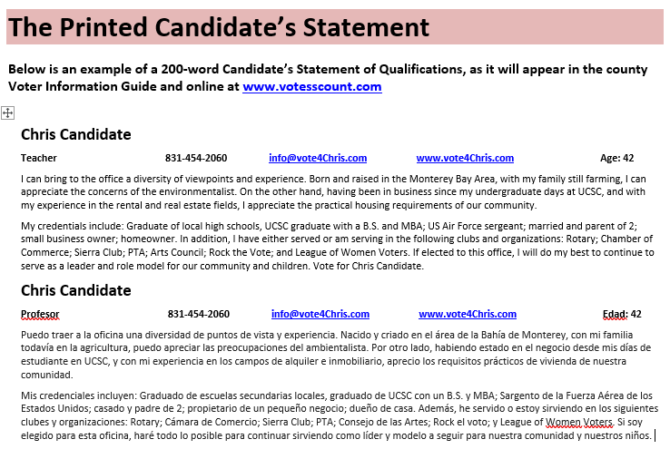

Slide 16
Filing your Statement of Qualifications
Candidate Statements must be submitted in an electronic format or pay $100 extra!!
E-mail your statement to candidates@votescount.us or bring in on a thumb drive.
File ONE signed hard copy by the deadline.
Payment: The statement may be paid for by check made payable to the County Clerk or cash if the candidate is using personal funds and will not be reimbursed through their campaign committee. The fee shall be paid at the time candidates file their Declarations of Candidacy.
Statements may not be changed but may be withdrawn no later than 5pm on March 14. If there is an extended filing time, no later than 5pm on March 17.

Slide 17
Important notices about Statements of Qualifications
Important notice to candidates in districts that encompass more than one county. Procedures, requirements, fees, formats and public examination periods for candidates’ statements may vary between counties. It is the candidate’s responsibility to contact each county (in which he or she wishes to have a statement printed) within the district to obtain the appropriate information from each county. Failure to do so may jeopardize the printing of the candidate’s statement. Candidates’ statements shall be filed in each county by the candidate.
It is strongly recommended that you file the statement personally. If the statement is filed by someone other than the candidate, that person should have the authority to make corrections or deletions to the statement in case there are errors or there are too many words. Statements received by mail prior to the deadline will be filed as long as they meet the statutory requirements and county policies regarding candidates’ statements. Statements may not be changed after filing.

Slide 18

Cost of Statement of Qualifications
Cost Formula: The cost of the Candidate’s Statement is based on a quarter page for 200-word statements or half page for 250-word statements.
The estimated cost of printing the statement in the county Voter Information Guide and posted online is $320, plus $.03 per voter in the district for printing and mailing the voter guide.
Candidates who do not submit their statement in a readable electronic format will pay $100 extra.
The optional Spanish statement will be $150 extra for print & online or online only.
Candidates can opt to have their statement posted online only for $320 in English, and $470 in English & Spanish.

Slide 19
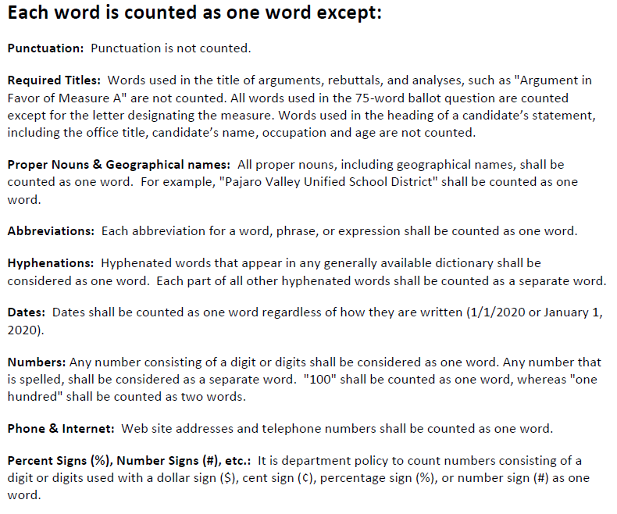
How to count words

Slide 20
Registration and Election Data
Confidential Voter File
Pursuant to Elections Code Sections 2187, 2188 and 2194, voter registration information is available to persons or groups for election, scholarly, journalistic or political purposes, or governmental purposes, as determined by the Secretary of State. Each written request to view, purchase, or use voter registration information must be submitted in person and with identification on an application available at the Santa Cruz County Elections Department.
Form to purchase voter file data is online at www.votescount.us
We also post who is purchasing data.

Slide 21
Voter Registration
Deadline is May 23.
Voters can register to vote online at www.registertovote.ca.gov.
Cards are available at post offices, city halls, DMV, or we can mail them to a voter.
Voter outreach limited due to COVID.
If a voter does not sign up in time, California now has Same Day Voter Registration where voters can register and vote up to and including Election Day.
Provisional voting will continue to be used in the event a voter’s eligibility cannot be determined at the time they show up to vote.
Voter Registration

Slide 22
How to return your ballot after voting from home
Voters may return their ballot in one of the following ways:
Drop it off at one of our 24-hour drop boxes
  Aptos - Cabrillo College Parking lot R by the stadium
  Aptos – Public Library, 7695 Soquel Dr.
  Aptos - Polo Grounds near the dog park, 2255 Huntington Dr.
  Ben Lomond - Highlands Park, 8500 Highway 9
  Capitola – 420 Capitola Ave in the City Hall parking lot
  Felton - Covered Bridge Park at Mt. Hermon and Graham Hill Rd
  Santa Cruz - 701 Ocean St in front of the County Government Center
  Santa Cruz – 212 Church St in the public parking lot
  Scotts Valley – 1 Civic Center Dr in the City Hall parking lot
  Watsonville – 316 Rodriguez St in the municipal public parking lot 14
  Watsonville – 1432 Freedom Blvd parking lot
  UCSC Quarry Plaza
  We will add up to two more drive-up drop off boxes for June.
Return it in person before and including Election Day at the County Elections Office or any of the City Clerks’ Offices.
Return it to a voter service center open Saturday, May 28 to Tuesday, June 7.
Mail it so it is received on time – ballots postmarked on or before Election Day and received by the June 14 will be considered received on time.

Slide 23

In-person voting options.
In-person voting options will be available for voters to do any of the following:
  Return a voted ballot
  Obtain a second ballot
  Vote on the accessible tablet
  Vote a Spanish ballot on the tablet
  Register and vote on the same day
  Vote provisionally
  Any other voting service
In-person voting locations will include the Santa Cruz County Clerk’s Office and Watsonville City Clerk’s Office.
3 voter service centers to serve voters will open on May 28, and 15 more on June 4. All centers will remain open until, Tuesday, June 7.
All centers will adhere to public safety guidelines regarding mask wearing, disinfecting, physical distances, and any other protocols that may be in place. Since this is an evolving situation and there is no way to know what will be happening in October, voters are directed to check the Santa Cruz County Elections Department’s website at www.votescount.us for the latest voting information.

Slide 24
Vote-by-mail safeguards
Postmark + 7
Vote-by-mail ballots that are postmarked on or before Election Day or is time stamped or date stamped by a bona fide private mail delivery company on or before Election Day and received by the county elections official by the 7th day after the election shall be considered received on time.
The signature on the ballot envelope is compared to the signature on file.
Cure for unsigned ballot envelopes or non-comparing signatures
Voters who failed to sign their vote-by-mail ballot envelope or has a signature that does not compare to what is on file will have until 2 days prior to the certification of the election to provide a signature on a Signature Statement to the County Elections Department. The Signature Statement may be returned to the County Elections Official by mail, FAX, email, hand-delivered, or dropped off at a voter service center or drop box.
No one can solicit the vote of a vote-by-mail voter, or do any electioneering, while in the residence or in the immediate presence of the voter, and during the time he or she knows the vote-by-mail voter is voting.
Any person who knowingly violates this section is guilty of a misdemeanor.

Slide 25
Know the laws!
What you can and can’t do
Use of public resources
Mass Mailings
Slate Mailers
Filing Nomination Documents
Campaign literature
Misrepresenting yourself
Deceptive online activities
Political advertising
Simulated ballots
Pictures in campaign mail
Corrupting the voting process
Vandalizing a voting location
Corrupting voters or intimidating voters
Political signs
Know the laws!
What you can and can’t do.

Slide 26
Raising and spending money
All candidates for state and local office are required to file campaign disclosure statements. Additionally, any committee formed to support or oppose a candidate or ballot measure is required to file campaign disclosure statements.
Form 501 Candidate Intention Statement – must be filed by all candidates prior to raising or spending a penny.
Form 410 Statement of Organization and Termination – must be filed by anyone who is raising or spending more than $2,000.
File within 10 days of reaching $2,000.
Name your campaign committee: must include the candidate’s last name, office sought and year of the election. Jones for City Council 2020
Send to SOS with $50, and you get your FPPC campaign ID number.
Find a good treasurer, and always make yourself the assistant treasurer.

Slide 27
More campaign filing forms!
NetFile
File online with NetFile. To set up an account go online to www.votescount.com or contact candidates@votescount.us or 831-454-2060.
Form 470
Officeholder & Candidate Campaign Statement – Short Form. Officeholders & candidates who do not have a controlled committee and do not anticipate spending or receiving $2,000 or more (including personal funds).
Form 460
Recipient Committee Campaign Statement. Filed by those who are raising or spending more than $2,000.
Form 496
24-Hour Independent Expenditure Report. Independent expenditures that total $1,000 must be reported as 24-hour independent expenditures during the 90 days immediately preceding the election.
Form 497
24-Hour Contribution Report. State and local committees making or receiving contribution(s) that total $1,000 or more in the 90 days before an election.

Slide 28
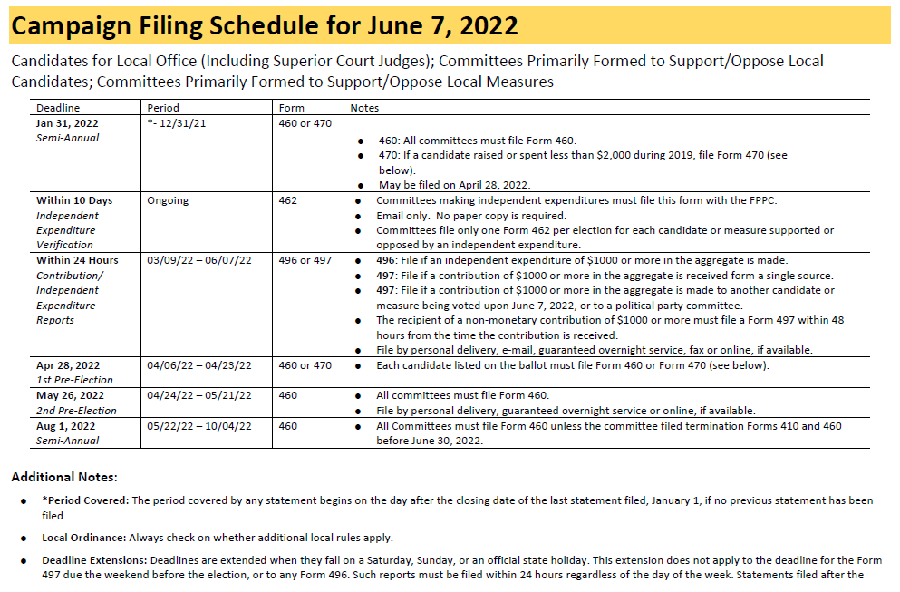

Slide 29

Don’t be late!
There are no provisions for granting “extensions” of the filing deadlines.
If a candidate, officeholder, or committee is required to file a statement and has failed to do so by the deadline, we will:
  Call you
  Provide written notice that statement must be filed within 10 days (5 days for 2nd Pre-Election Statement) noting that a fine of $10 per day beginning the day after the filing deadline until the date the statement is filed will be assessed unless waived by the Elections Official. The maximum penalty is $100 or the total amount of contributions received or the total amount of expenditures made (whichever is greater) during the period covered by the late statement.
Fines may not be waived if statement is not filed within 10 days after specific notice is sent by the elections official (or 5 days for 2nd Pre-Election Statements).
Failure to file a statement after appropriate notice will be referred to an enforcement official and can result in substantial criminal, civil and administrative penalties.

Slide 30
Need Help?
Contact the FPPC!
Email: advice@fppc.ca.gov
or
Phone: 866-ASK-FPPC (1-866-275-3772)
Telephone advice is available
Monday through Thursday: 9am - 11:30am
Other Resources:
Candidate Toolkit: http://fppc.ca.gov/learn/campaign-rules/candidate-toolkit-getting-started.html
Online video and slides: http://www.fppc.ca.gov/learn/campaign-rules/candidate-and-treasurer-online-video.html
Workshops: available on the FPPC website https://www.fppc.ca.gov/learn/training-and-outreach.html

Slide 31
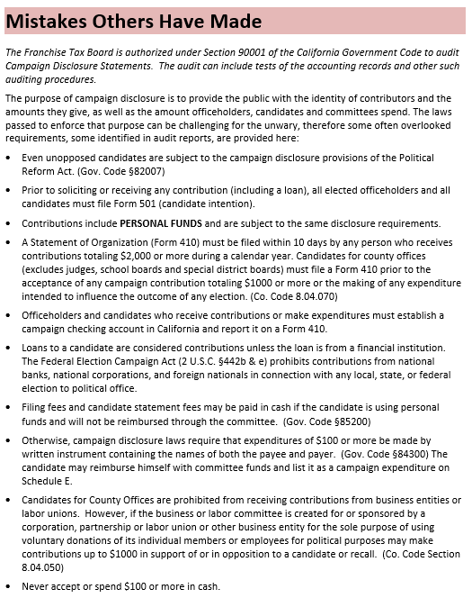
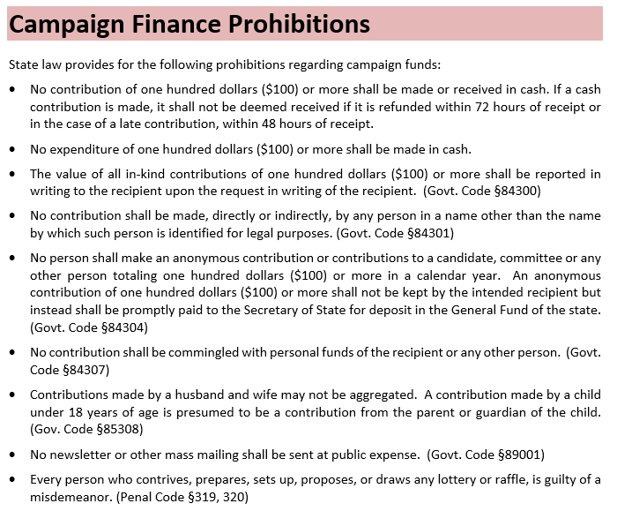
Two of my favorite pages in the Candidate’s Handbook

Slide 32
Form 700 Conflict of Interest Statement
File online with NetFile. To set up an account for school or special district candidates go online to www.votescount.com or contact candidates@votescount.us or 831-454-2060.
As a candidate, you are required to file a Form 700. It is a public document where you will disclose your financial interests.
The Form 700 provides transparency and ensures accountability in governmental decisions.

Slide 33
Write-in Candidates
File April 11 to May 24
Persons who did not file a Declaration of Candidacy and fulfill their nomination requirements to place their name on the ballot may run for office as a write‑in candidate.
Voters may write‑in any person they wish for any office regardless of whether the person has qualified or not. However, the votes will only be tabulated for qualified write-in candidates.
To qualify as a write‑in candidate, a person must file with the County Clerk/Elections Department the following documents:
A “Statement of Write‑in Candidacy” which shall contain the candidate's name, residence address, a declaration stating that he or she is a write‑in candidate, the title of the office for which he or she is running and the date of the election.
For county offices, if there is a run-off, a statement that the candidate meets the statutory and constitutional requirements for that office as described in that section. §8600 (a)(8)
A Nomination Petition with the required number of signers for the office sought. In November, the offices include: County Supervisor and City Council.
Signers of nomination papers for write‑in candidates shall be voters in the district or political subdivision in which the candidate is to be voted on. §8603

Slide 34
Election Night
Polls close at 8pm
Ballot drop boxes close at 8pm
We will continue to process and tally ballots until 11pm.
At 11pm, we will focus on scanning and final counting of the ballots we have in the system.
Semi-official election night results will be released sometime after midnight.
History has shown that we will count more ballots after Election Day than on Election Night.
So, no victory parties yet! Results are NOT final until all votes are counted, audited, and verified.
Election officials are big fans of big margins!!

Slide 35


The Canvass
Like fine wine, it takes time.
The Canvass is the official tally of votes for any given election. The purpose of the canvass is to account for every ballot cast and ensure that every valid vote cast is counted accurately in the final election totals.
The Canvass accounts for every ballot cast on Election Day, every qualified returned ballot from voters who voted using the ballot we mail them, every qualified Same Day Voter Registration ballot, every accepted provisional ballot, every challenged ballot, and every qualified military and overseas ballot.
The Canvass enables an election official to resolve discrepancies, correct errors, and take any remedial actions necessary to ensure completeness and accuracy before certifying the election.
Estimated number of outstanding ballots will be prepared by Friday, including the number of Same Day and Provisional Ballots. We will not have the number by district until the ballots are all keyed in as returned.
There are several audits conducted during the Canvass to verify the results including a 1% manual tally of the results making sure every contest is audited.

Slide 36
Questions?
Feedback?
Tricia Webber
Santa Cruz County Clerk
831-454-2409
tricia.webber@santacruzcounty.us
Lynn Stipes
Candidate Filing Team
831-454-2416 lynn.stipes@santacruzcounty.us
Lilly Galvan
Candidate Filing Team
831-454-2405 liliana.galvan@santacruzcounty.us
candidates@votescount.us
831-454-2060

